Slide 1
Natural Language Processing
Unit 10 Semantic Analysis: Semantic Relatedness
Faizan Javed
DataScience @ SMU

Slide 2
Admin notes
Start of second half of the course

Slide 3
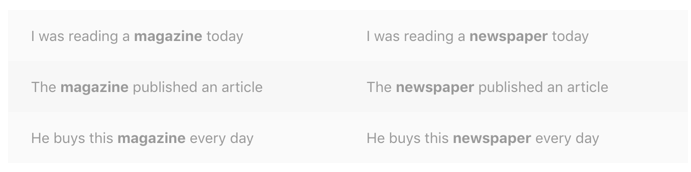
Distributional hypothesis
Words which are similar in meaning occur in similar contexts (Rubenstein & Goodenough, 1965).
If we want to find a word similar to “magazine”, we can look for words that occur in similar contexts, such as “newspaper”.

Slide 4
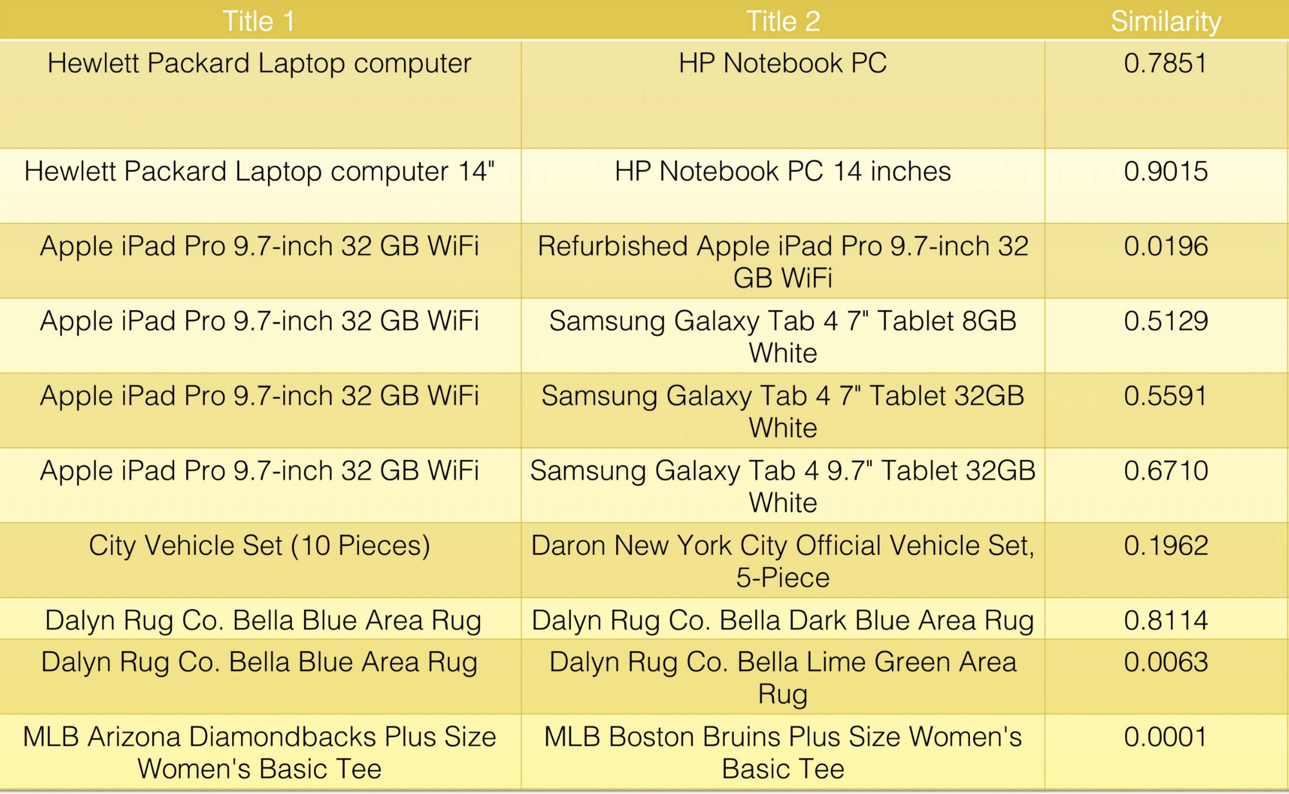
Semantic Similarity
Term (Word) similarity: similarity between individual tokens or words.
Document similarity:
similarity between (short) text documents.

Slide 5
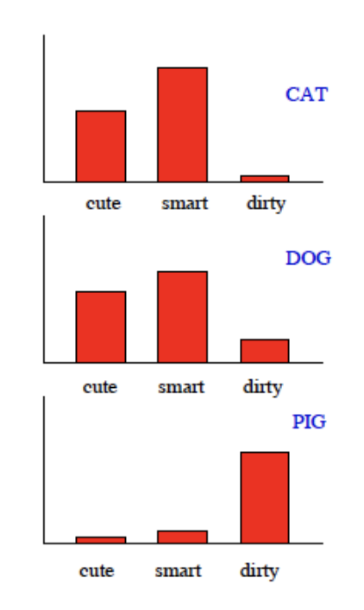
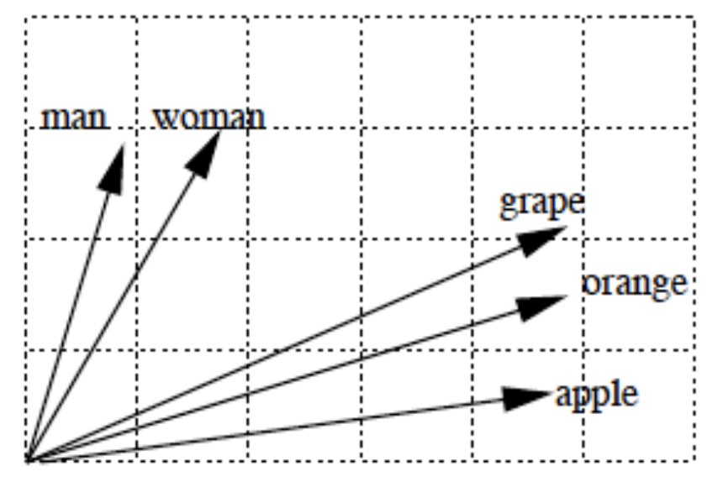
Semantic Similarity - “visual” representations

Slide 6
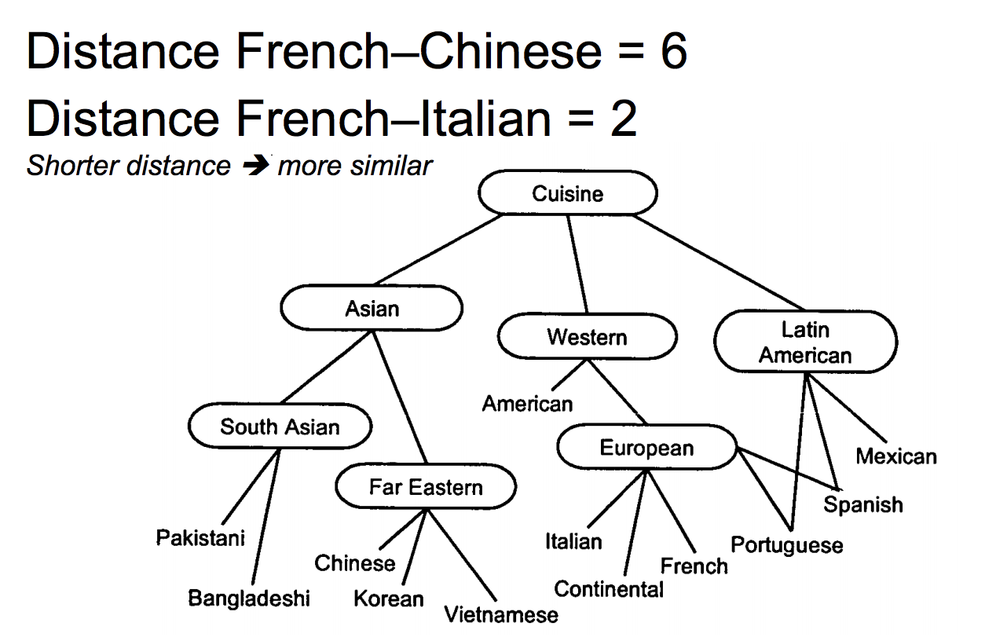
Word similarity approaches - structural
Distance in a semantic graph
Overlap in parse contexts
Ontological distance

Slide 7
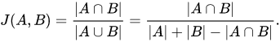
Word similarity approaches – statistical
Jaccard similarity:
Sentence A: AI is our friend and it has been friendly Sentence B: AI and humans have always been friendly
After lemmatization “friend” and “friendly” will both become “friend”, “has” and “have” will both become “has”.
J(A, B): 5/(5+3+2) = 0.5
Note that the word friend appeared twice in sentence A, but didn’t affect the calculations.
Use case: Jaccard similarity is good for cases where duplication does not matter

Slide 8
Word similarity approaches – statistical
Cosine similarity:
Measures the cosine of angle between two vectors

Slide 9
Word similarity approaches – statistical
Cosine similarity:
Measures the cosine of angle between two vectors
Sentence 1: AI is our friend and it has been friendly Sentence 2: AI and humans have always been friendly
Convert sentences into vectors: BOW (bag of words) model
TF (term-frequency): count of words in a sentence
TF-IDF (term-frequency – Inverse-document-frequency): takes into account rareness of a term in a document

Slide 10
Word similarity approaches – statistical
TF favors longer sentences or documents, so normalize TF values (e.g., L2 norm)
Cosine (1, 2) = 0.684
Repeating the word “friend” in sentence-1 drops the cosine sim to 0.4
Use case: Cosine similarity is good for cases where duplication does matter

Slide 11
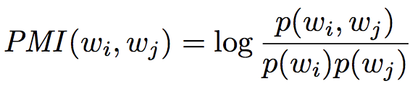
Word similarity approaches – statistical
PMI – pointwise mutual information
Metric to identify events that frequently co-occur (“words that go-together”)
Two events x, y are independent if their joint probability is equal to the product of their individual probabilities:
x,y are independent iff p(x,y) = p(x)p(y)
Find pairs of words wi, wj that have high pointwise mutual information:

Slide 12
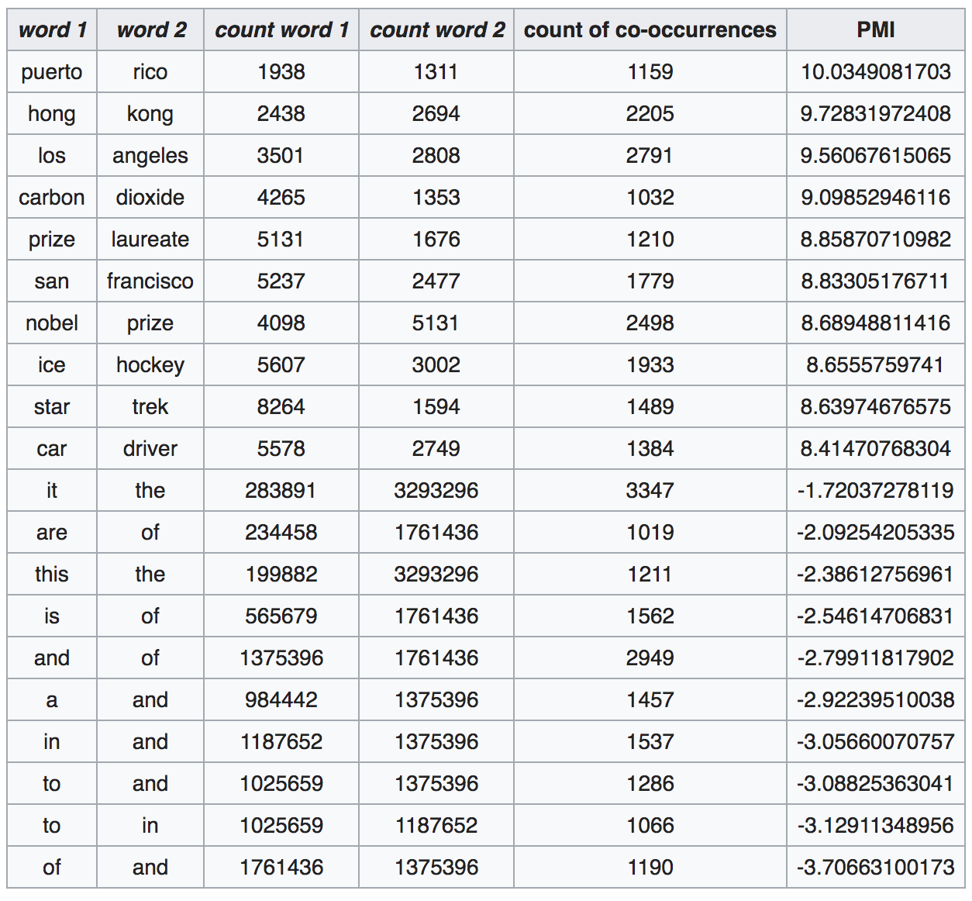
Word similarity approaches – statistical
PMI – pointwise mutual information
The following table shows counts of pairs of words getting the most and the least PMI scores in the first 50 million words in Wikipedia (dump of October 2015) filtering by 1,000 or more
co-occurrences.

Slide 13
Sparse vs dense vectors
Distributional similarity – uses context
Traditional approaches represent words as sparse vectors:
Each dimension represents one specific context
Vector entries are based on word-context co-occurrence statistics (counts or PMI values)
Dense vector representations:
Use Singular Value Decomposition to turn these sparse vectors into dense vectors (Latent Semantic Analysis)
Use neural models to explicitly learn a dense vector representation (embedding) (word2vec, Glove, etc.)

Slide 14
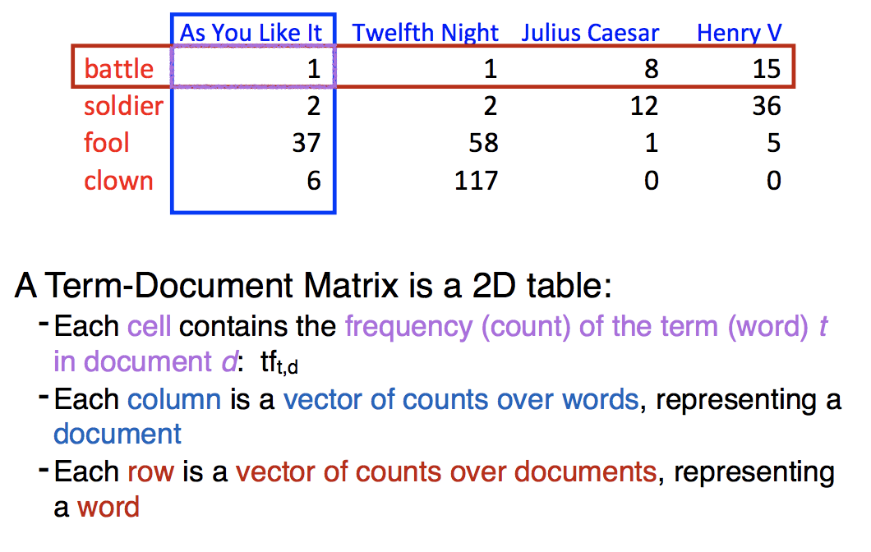
Sparse vs dense vectors

Slide 15
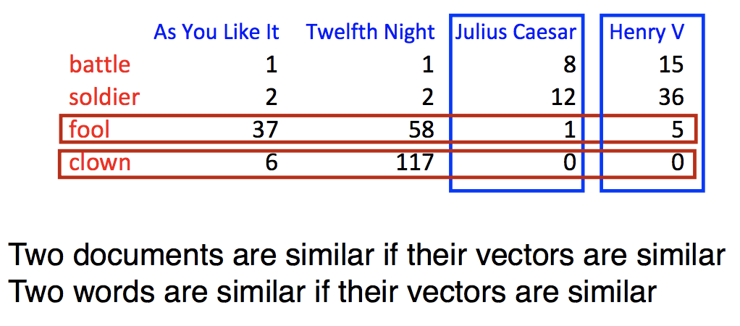
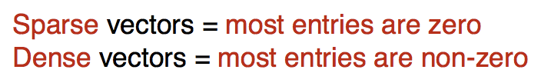
Sparse vs dense vectors

Slide 16
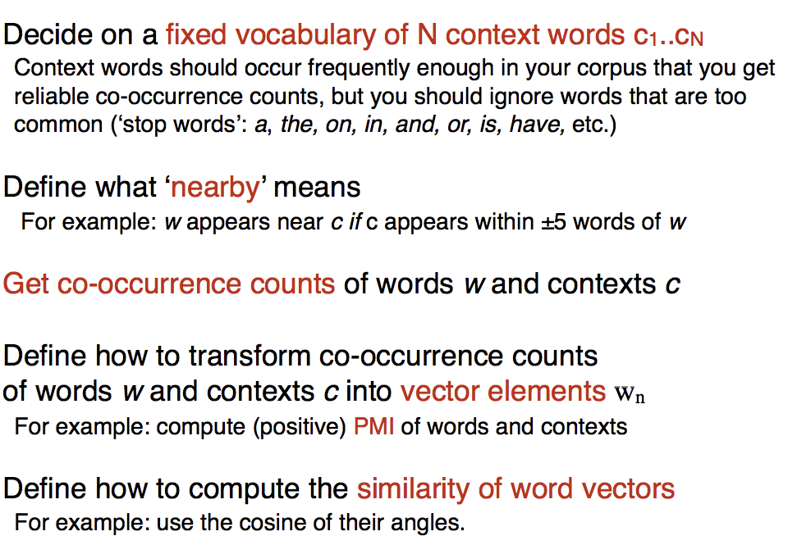
Context and co-occurances

Slide 17
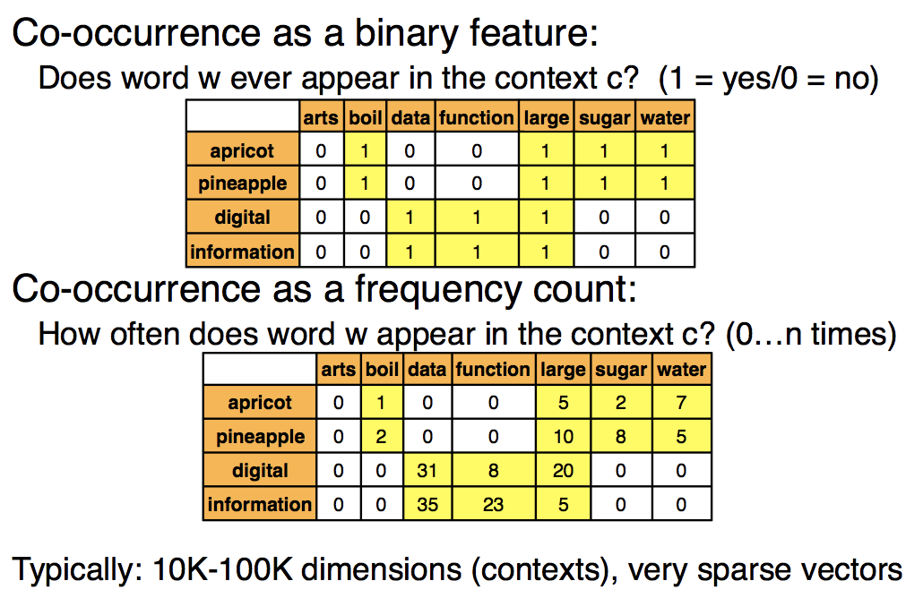
Context and co-occurances

Slide 18
Word vectors with word2vec Distributed representations of words and phrases and their compositionality https://papers.nips.cc/paper/5021-distributed-representations-of-words-and-phrases-and-their-compositionality.pdf
Vector of weights: 1-of-N (one-hot encoding)
Word vector: corresponding element is set to one, and all elements are zero
Given vocabulary: King, Queen, Man ,Woman, Child
Vector for Queen:
Distributed representation of a word = each word is represented by a distribution of weights across all elements
“meaning of a word”
This kind of vector composition lets us answer
“King – Man + woman = Queen”
This is done only looking at lots of words in context
and no semantics!

Slide 19
Word vectors with word2vec
Vectors for King, Man, Queen and Woman:
Vector (King) – Vector (Man) + Vector (Woman)
= Vector (Queen)

Slide 20
Word vectors with word2vec
Word relationships:
‘a is to b as c is to ?’
analogical reasoning:

Slide 21
Word2vec - models
Complexity of neural network language models comes non non-linear hidden layers. Word2Vec models are simpler (probably not as accurate) but more scalable
Continuous Bag of Words (CBOW):
Sliding window of context words
Each word is coded in one-hot form
Single hidden layer and single output layer
Training objective: maximize the conditional
probability of observing the actual output word
(the focus word) given the input context words,
with regard to the weights
E.g., the input (“an”, “efficient”, “method”, “for”,
“high”, “quality”, “distributed”, “vector”)
maximize the probability of getting “learning”
as the output.

Slide 22
Word2vec - models
Skip-gram:
Opposite of the CBOW model
Focus word is the single input vector, and the target
context words are the output layer
Training objective: minimize the summed prediction error across all context words in the output layer.
E.g., the input would be “learning”, and we hope to see
(“an”, “efficient”, “method”, “for”, “high”, “quality”,
“distributed”, “vector”) as the output.
Skip-gram: works well with small amount of training data, is able to represent well rare words and phrases well.
CBOW: several times faster to train than skip-gram, slightly better accuracy for frequent words

Slide 23
Doc2Vec - Distributed Representations of Sentences and Documents, Le, Mikolov, 2014 https://arxiv.org/abs/1405.4053
Create a numeric representation of a document
PV-DM: Distributed Memory version of Paragraph Vector
Extension to the CBOW model: add another feature vector
This new feature vector is the topic of the paragraph
PV-DBOW: Distributed Bag of Words version of Paragraph Vector
(Extension to skip-gram)
PV-DM is recommended by authors
Use case: a training set of documents,
a word vector W is trained for each word
a document vector D is trained for every document,
train weights for softmax hidden layer
Inference: given a document, return document vector.

Slide 24
Dynamic word embeddings Dynamic word embeddings for evolving semantic discovery Yao et al., WSDM’18 https://arxiv.org/abs/1703.00607
”Human language is an evolving construct”

Slide 25
Dynamic word embeddings Dynamic word embeddings for evolving semantic discovery Yao et al., WSDM’18 https://arxiv.org/abs/1703.00607
The alignment problem:
When you learn an embedding for a word in one time window (e.g., ‘bank’), there’s no guarantee that the embedding will match that in another time window, even if there is no semantic change in the meaning of the word across the two.
So the meaning of ‘bank’ in 1990 and 1995 could be substantially the same, and yet the learned embeddings might not be.
Temporal Word embeddings: learn temporal embeddings in all time slices concurrently, and apply regularization terms to smooth embedding changes across time.

Slide 26
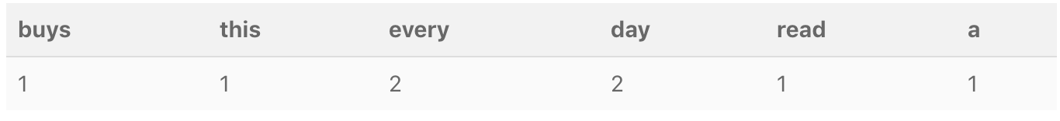
Don’t count, predict! Don’t count, predict!, ACL 2014 https://www.aclweb.org/anthology/P14-1023.pdf
Count models:
”Newspaper” example: Define window size – count number of words.
“He buys this newspaper every day” “I read a newspaper every day” Window size = 2
For good performance, turn these counts into something more informative (“Weighting scheme”)
Downweight frequent terms (“a” “this”), upweight more unique words (“read”, “buys”)
Can use PMI, LMI (Local Mutual Information) as weighting schemes
Use compression techniques such as SVD and Non-negative Matrix Factorization to create “dense” vectors

Slide 27
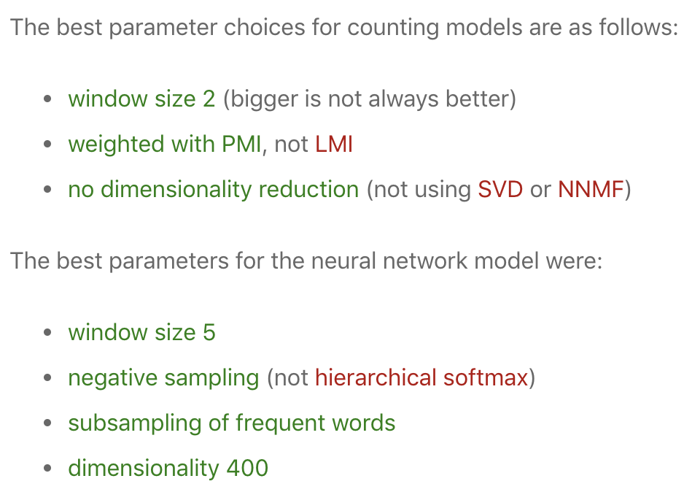
Don’t count, predict! Don’t count, predict!, ACL 2014 https://www.aclweb.org/anthology/P14-1023.pdf
Predict model: word2vec, CBOW: down samples very frequent words “a”, “the”, et al)
Training: models trained on a corpus of 2.8 billion tokens, combining ukWac, the English Wikipedia and the British National Corpus. Used 300,000 most frequent words as both the context and target words.
Predict models give a large improvement on the tasks of
semantic relatedness, synonym detection and
analogy detection.
The performance is equal or slightly
better on categorization.
Predict models are less sensitive to parameter choices.

Slide 28
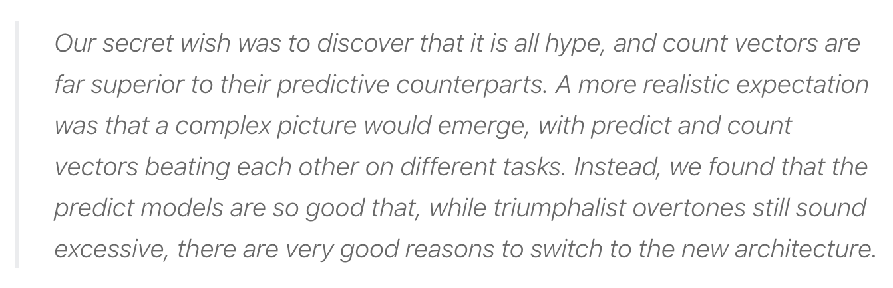

Slide 29
What did you learn today?
Questions?

